Slide 1
HR
HR ANALYTICS
DASHBOARD
DATA-DRIVEN
PEOPLE ANALYTICS
Comprehensive Workforce Intelligence Report
50,000
50.21%
$26K
Employees
Attrition Rate
Avg Income
Powered by Power BI · Tableau · Excel · SQL
TOOLS USED
Power BI
Tableau
Excel
MySQL
Confidential — HR Analytics Project | 2024

Slide 2
Project Overview
Scope, Objectives & Methodology
KEY OBJECTIVES
DATASET OVERVIEW
01
Analyze workforce attrition patterns across departments, roles, and demographics
HR_1.xlsx
50,000 rows · 18 columns
Core employee demographics, job role,
education, satisfaction scores
02
Identify key drivers of employee turnover using multi-tool analytics
HR_2.xlsx
50,000 rows · 18 columns
03
Build interactive dashboards in Power BI, Tableau & Excel for business insights
Compensation, working years, overtime,
work-life balance, promotion history
04
Write optimized SQL queries to extract and validate HR KPIs from raw data
TOOLS & TECHNOLOGIES
Power BI
Tableau
Interactive dashboards & DAX
Visual analytics & stories
05
Deliver actionable recommendations to reduce attrition and improve retention
Excel
MySQL
Pivot tables & charts
Data extraction & KPI queries

Slide 3
Key Metrics at a Glance
Summary of workforce analytics across 50,000 employees
50,000
50.21%
$26,016
38.97 yrs
115.43
Total Employees
Attrition Rate
Avg Income
Avg Age
Avg Hourly Rate
ATTRITION RATE BY DEPARTMENT
ATTRITION BY GENDER

Slide 4
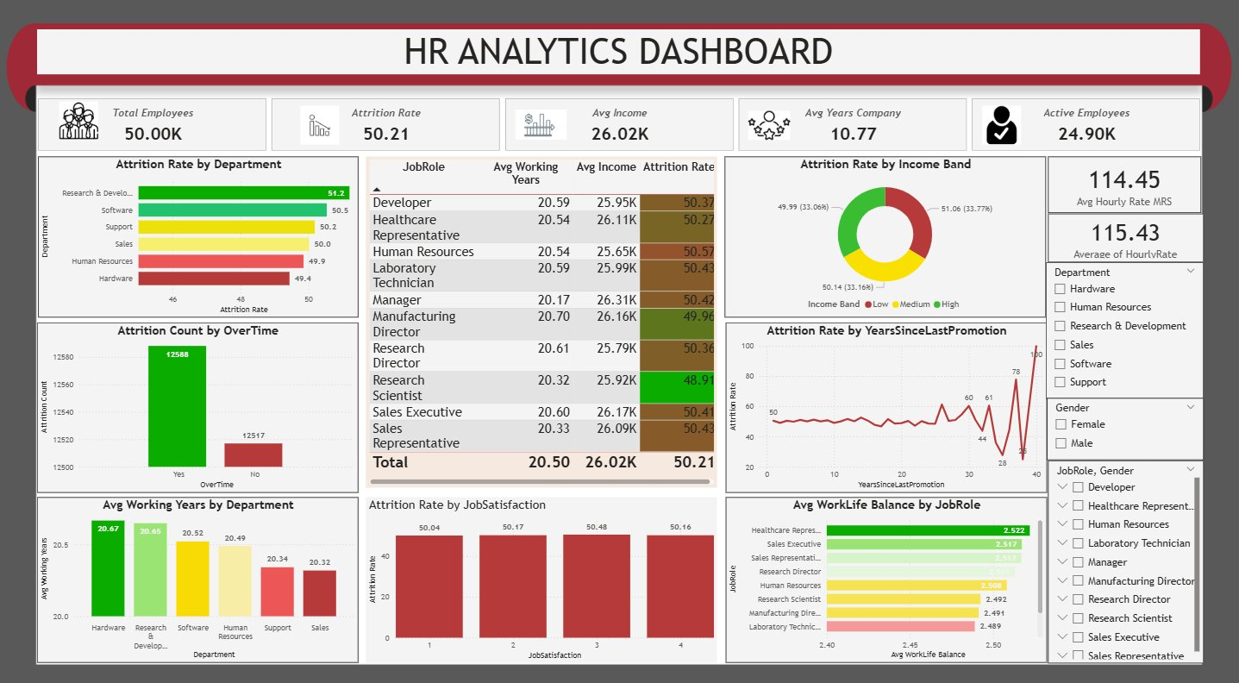
Power BI Dashboard
Interactive Business Intelligence — Attrition, Income & Department Analytics
DASHBOARD HIGHLIGHTS
KPI Cards
Total employees, attrition rate, avg income, hourly rate & active staff
Dept Analysis
Attrition rate by department — R&D leads at 51.2%
Income Band
Donut chart: Low / Medium / High income distribution
Job Role Table
Avg working years, income & attrition by all 10 roles
Overtime Impact
Attrition count split by overtime status
Filters
Interactive slicers for dept, gender & job role

Slide 5
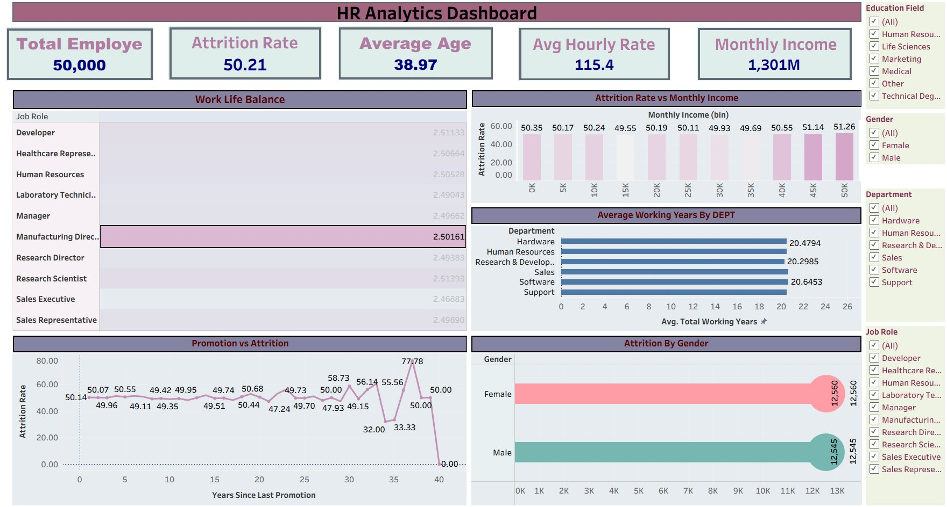
Tableau Dashboard
Visual Analytics — Promotion Patterns, Income Distribution & Gender Insights
DASHBOARD HIGHLIGHTS
WLB by Role
Work-life balance scores for all 10 job roles compared
Income Chart
Attrition rate vs monthly income bins (0K to 50K+)
Promotion vs Attrition
Line chart: years since promotion vs attrition rate
Avg Working Years
Horizontal bar: average tenure by department
Gender Attrition
Female: 12,560 | Male: 12,545 attrition counts
Filter Panel
Slicers: Education Field, Gender, Department, Job Role

Slide 6
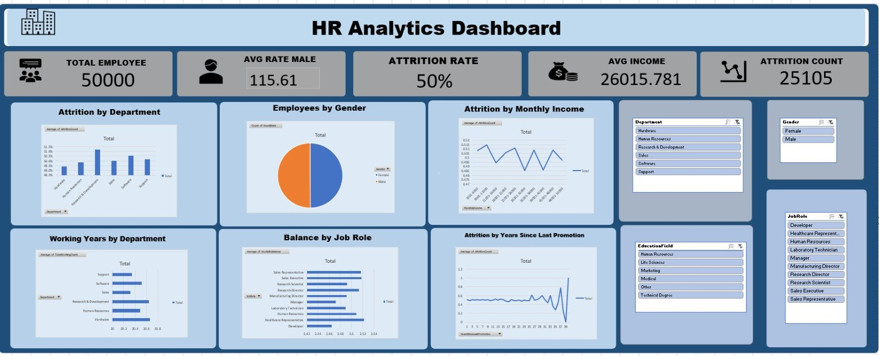
Excel Dashboard
Pivot-Driven Analytics — Attrition, Gender Split & Working Years
DASHBOARD HIGHLIGHTS
KPI Row
Total employees (50K), avg male rate, attrition & avg income
Dept Attrition
Column chart showing attrition rate per department
Gender Split
Pie chart: near-equal male/female distribution
Income Attrition
Line chart: attrition rate vs monthly income ranges
WLB by Role
Horizontal bar comparing work-life balance scores
Filter Slicers
Department, Gender, EducationField, JobRole slicers

Slide 7
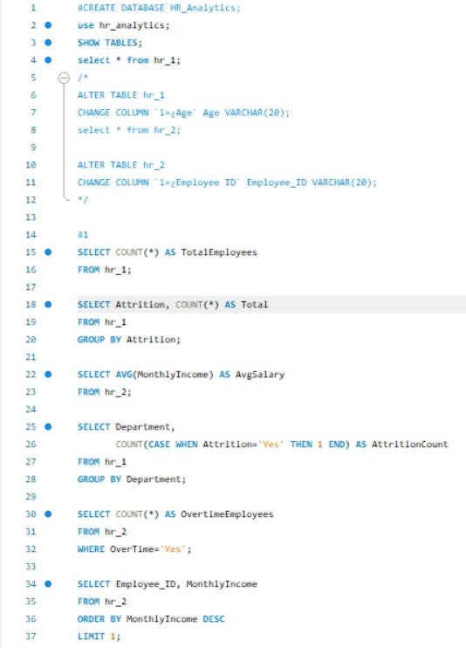
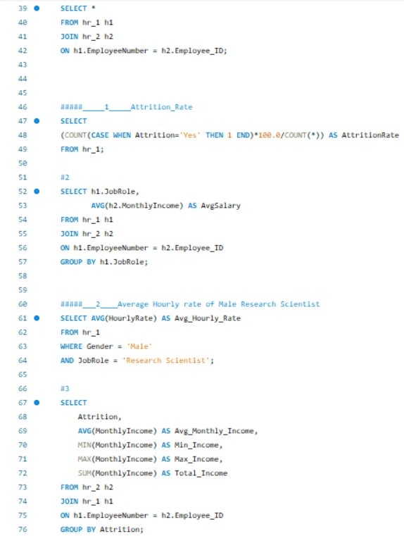
SQL Analysis — Part 1
Data extraction, KPI computation & joined queries on HR_1 and HR_2
QUERIES COVERED
COUNT(*)
Total employee headcount from HR_1
GROUP BY Attrition
Attrition count — Yes vs No split
AVG(MonthlyIncome)
Average salary from HR_2 table
COUNT(CASE WHEN...)
Attrition count per department
WHERE OverTime='Yes'
Overtime employee count filter
ORDER BY Income DESC
Top earner by employee ID
JOIN ON EmployeeNumber
Full inner join HR_1 × HR_2
Attrition Rate %
COUNT(Yes)*100.0/COUNT(*) formula

Slide 8
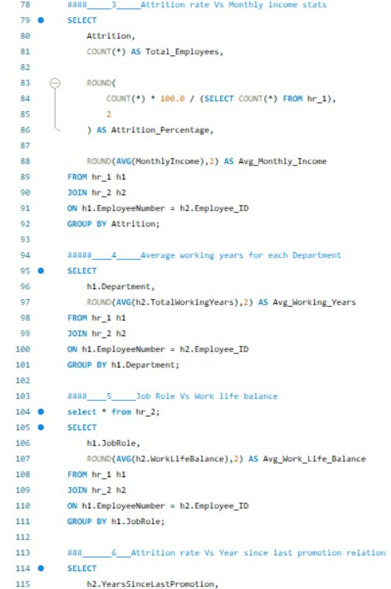
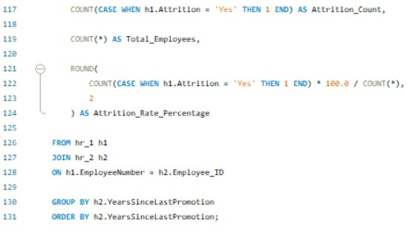
SQL Analysis — Part 2
Advanced aggregations, KPI analysis & promotion-attrition relationships
ADVANCED QUERIES
AVG/MIN/MAX/SUM Income
Income stats grouped by attrition status
Attrition Rate %
Rounded attrition % with COUNT(CASE WHEN)
Avg Working Years / Dept
ROUND(AVG(TotalWorkingYears),2) by dept
JobRole vs WLB
Work-life balance average per job role
YearsSinceLastPromotion
Attrition rate by promotion recency
COUNT(*) * 100.0
Proper percentage calculation pattern

Slide 9
Deep-Dive Analysis
Attrition drivers, income patterns & workforce tenure insights
ATTRITION RATE BY DEPARTMENT (%)
AVG MONTHLY INCOME BY JOB ROLE ($)
AVG TOTAL WORKING YEARS BY DEPARTMENT
WORK-LIFE BALANCE BY JOB ROLE (Avg Score)

Slide 10
Key Findings & Insights
Critical patterns uncovered from HR analytics across all tools
01
High Attrition Rate
04
Overtime Factor
50.21% overall attrition — R&D dept leads at 51.2%
Overtime Yes: 12,534 | No: 12,571 attrition counts
Nearly equal turnover across all departments suggests systemic, org-wide issue rather than department-specific problems
Overtime has minimal differential impact on attrition — both groups show nearly identical turnover rates
02
Income & Attrition
05
Tenure Patterns
Avg monthly income: $26,016 with minimal role variation
Avg total working years: ~20.5 years across all depts
Narrow income range ($25.8K–$26.4K) across roles suggests compensation alone is not a primary attrition driver
Software (20.65) and Sales (20.62) show slightly higher tenure — suggests stronger retention in these departments
03
Gender Parity
06
Work-Life Balance
Female: 12,560 | Male: 12,545 attrition counts
Research Scientists score highest WLB (2.514/5.0)
Near-equal attrition by gender indicates no significant gender-based disparity — policies affecting all employees equally
Sales Executives have the lowest WLB score (2.469) — targeted interventions in sales could improve retention

Slide 11
Recommendations
Strategic actions to reduce attrition and improve workforce retention
01
HIGH PRIORITY
02
HIGH PRIORITY
Implement Retention Programs
Address Work-Life Balance
▸ Conduct stay interviews with long-tenure employees
▸ Focus on Sales Executive role — lowest WLB score (2.469)
▸ Create structured career progression paths for all roles
▸ Implement flexible work arrangements across departments
▸ Introduce retention bonuses at 3-year and 5-year milestones
▸ Monitor and cap overtime hours with wellness programs
03
MEDIUM PRIORITY
04
MEDIUM PRIORITY
Review Compensation Strategy
Promote Career Development
▸ Narrow income band ($25.8K–$26.4K) may reduce motivation
▸ Employees with recent promotions show lower attrition
▸ Introduce performance-linked variable pay components
▸ Establish clear promotion timelines and criteria
▸ Benchmark compensation against industry standards
▸ Invest in training programs (tracked via TrainingTimesLastYear)

Slide 12
THANK YOU
PROJECT SUMMARY
50K
Employees Analyzed
This project demonstrates end-to-end data analytics capabilities using industry-standard BI tools. From raw Excel data to interactive dashboards and SQL-driven KPIs, the HR Analytics project showcases proficiency in transforming data into strategic business insights.
4
Tools Deployed
2
Datasets Merged
SKILLS DEMONSTRATED
Power BI
Tableau
6
SQL KPIs Built
DAX measures, slicers, KPI cards
Calculated fields, dual-axis charts
Excel
MySQL
3
Dashboards Created
Pivot tables, dynamic charts
JOINs, GROUP BY, CASE WHEN
HR Analytics Project | Data Analyst Portfolio | 2024

